Slide 1

GeNS Mechanical Loss Measurment as a Function of Sample Balance Point
Department of Physics and Astronomy
Naomi Borg- Aerospace Engineering Astronautics

Slide 2
Acknowledgments
Thank you to Dr. Andri Gretarsson and Dr. Ellie Gretarsson for being wonderful mentors on this project and thank you to Space Grant for supporting this research
Notes:
Full text slide

Slide 3
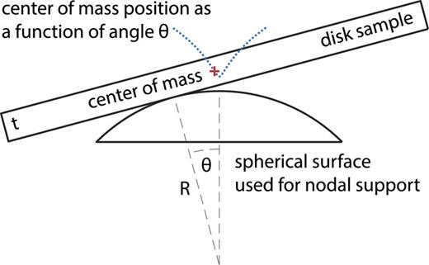
Gentle Nodal Suspension
Single contact point
Silicon, fused silica, and/or sapphire
Ring-Down Experiments
Interferometry (LIGO)
How does the balance point angle affect the mechanical loss in the system?
Image Source: A high throughput instrument tomeasuremechanical losses in thin film coatings | Review of Scientific Instruments | AIP Publishing
Notes:
General introduction slide

Slide 4
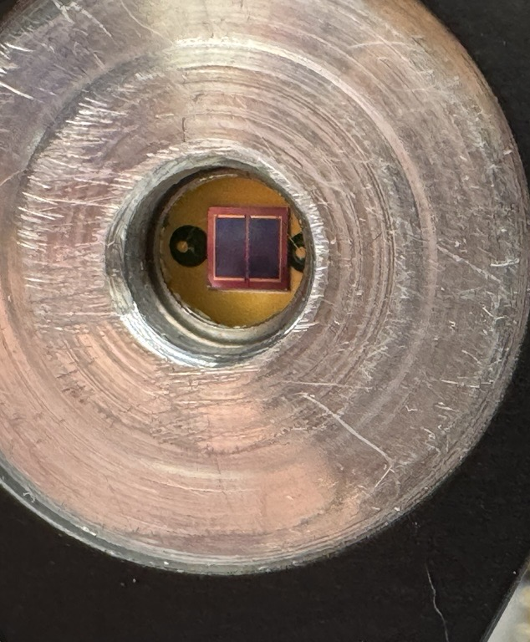
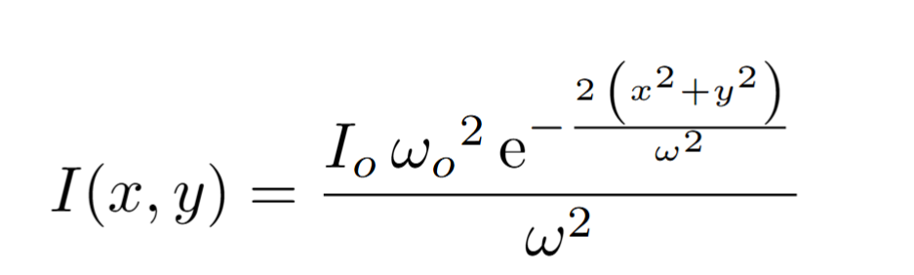
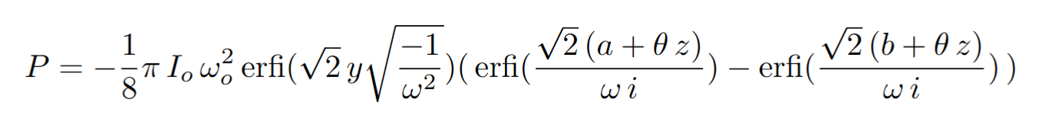
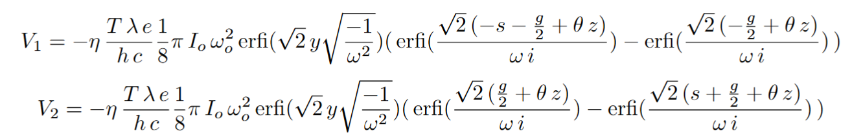
Simulation for Optical Lever comparison
Set-Up
g
Irradiance
y
s
Integrate to Power
Convert to voltage equations for both diodes
Notes:
Full text slide

Slide 5
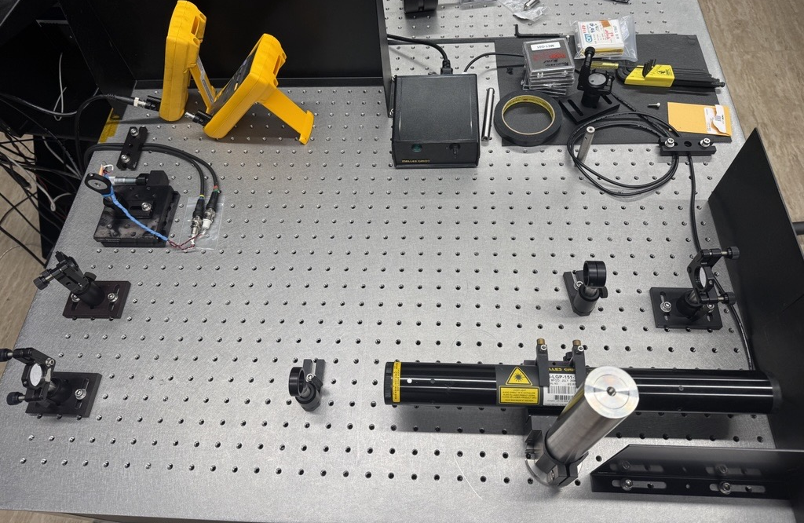
Simulation for Optical Lever comparison
Set-Up
Difference Readout
Additive Readout
Adjustable mount with Split Photo Diode
Focus
Mirror
Mirror
Green Laser
Mirror
Filter
Notes:
Full text slide

Slide 6
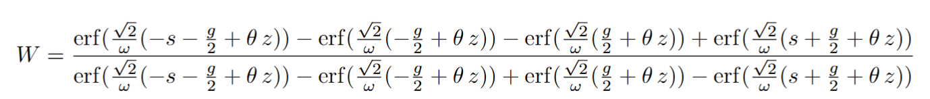
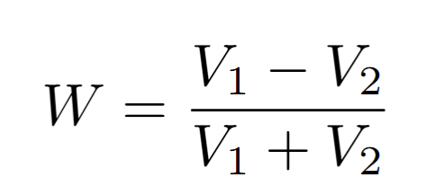
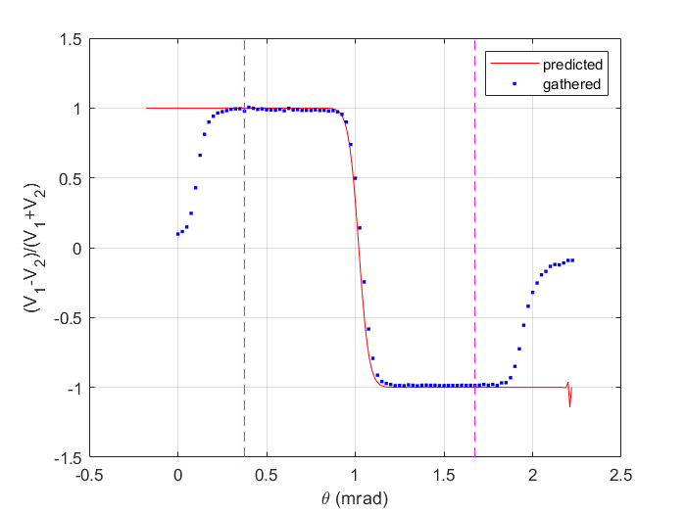
Simulation for Optical Lever comparison
Set-Up
Notes:
Full text slide

Slide 7
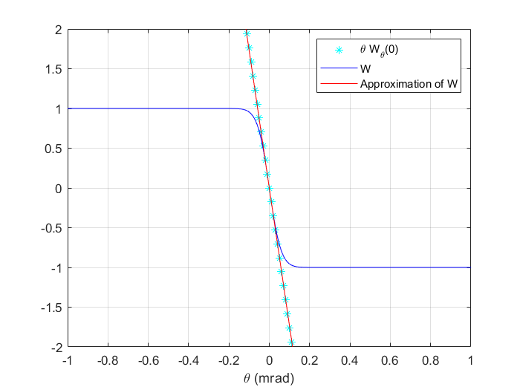
The Slope Line
Set-Up
Notes:
Full text slide

Slide 8
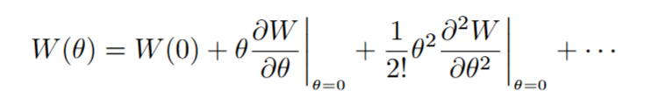
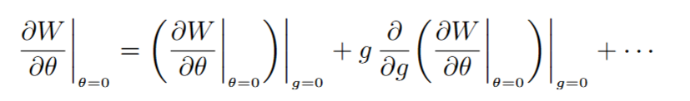
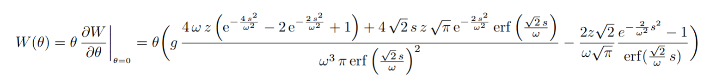
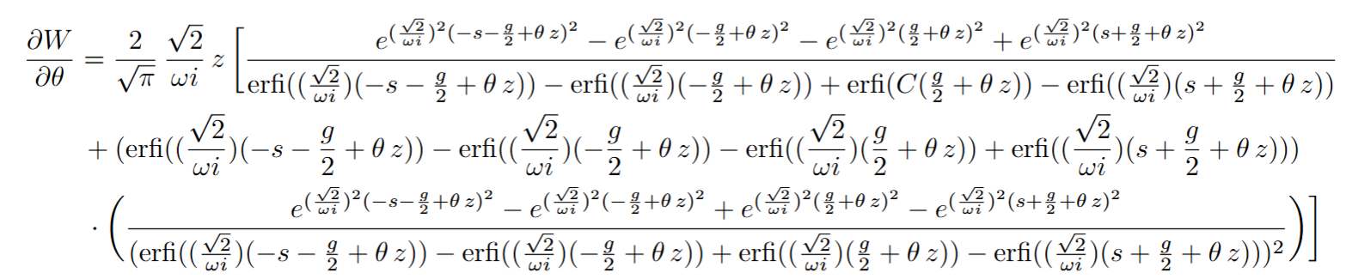
The Slope Line
Set-Up
Approximation using the
Taylor expansion
The derivative by theta of W
Notes:
Full text slide

Slide 9
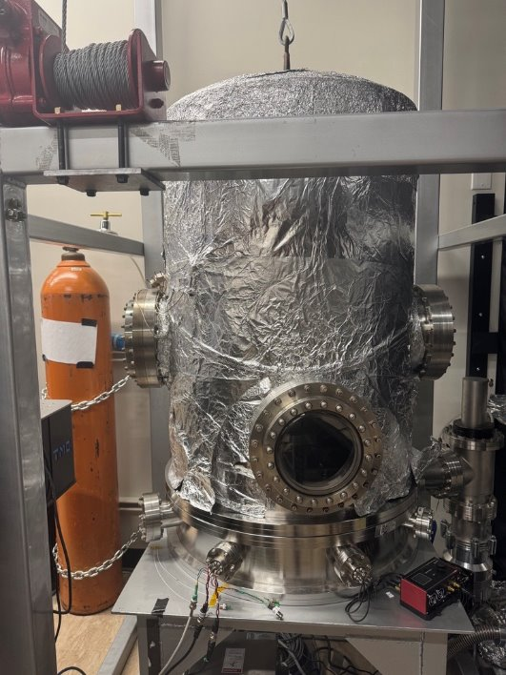
Next Steps
Set-up the vacuum chamber with the optical lever and GeNS apparatus
Move the balance point in a grid like pattern and record the resulting function by angle
Compare the recorded lines with the control simulation and results
Notes:
Full text slide

